Slide 1
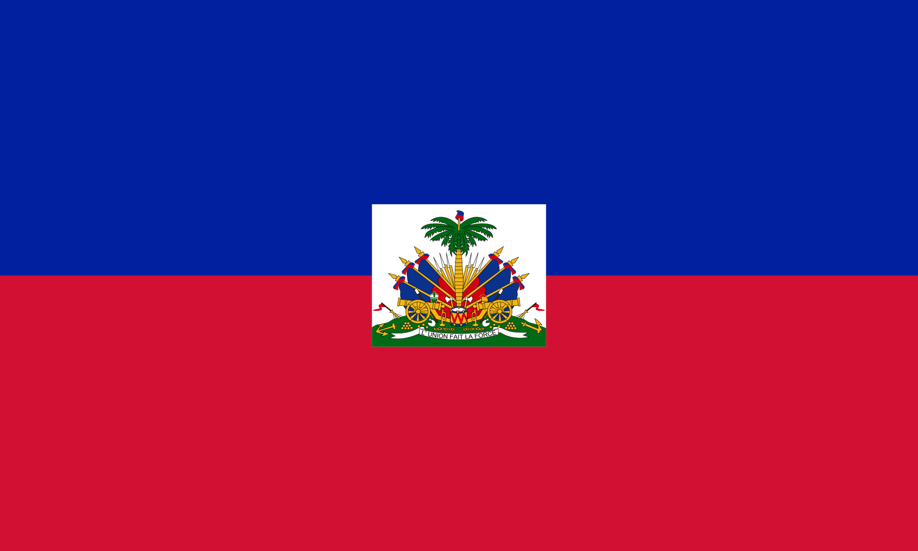
The Haitian Flag
Lecture on Haitian (1791-1804) And U.S. Rebellions (1800-1831)
The Haitian flag: With its bicolor background, the coat of arms symbolizes weapons that represent the nation's readiness to defend its freedom. The royal palm represents independence.

Slide 2
See Video Before Class
Neglected History: The Haitian Revolution 12 min.
https://www.youtube.com/watch?v=HjsHGL_DPsc

Slide 3
Pop Quiz: Questions About the Clip
What was the name of the entire island named by Christopher Columbus?
What crops emerged to make the colony one of the most important of the Antilles?
What was the French half of the island named before being named Haiti?
What does the word Haiti mean?
Why were enslaved Haitians able to keep their African languages and cultures?

Slide 4
Continued . . .
Can you describe how its social hierarchy made Haiti such a volatile place before the Revolution?
What event served as a catalyst for the Haitian Revolution, what year did it occur, who led it?
Why was this event so effective in sparking the Revolution?
What is a maroon?
Who were four important lack leaders of the Haitian Revolution?

Slide 5
Vocabulary
Maroon
A member of any of various communities in parts of the Caribbean who were originally descended from escaped slaves. In the 18th century Jamaican Maroons fought two wars against the British settlers, both of which ended with treaties affirming the independence of the Maroons.
The French National Convention
The assembly that governed France from September 20, 1792, until October 26, 1795, during the most critical period of the French Revolution. The National Convention was elected to provide a new constitution for the country after the overthrow of the monarchy (August 10, 1792). The Convention numbered 749 deputies, including businessmen, tradesmen, and many professional men. Among its early acts were the formal abolition of the monarchy (September 21) and the establishment of the republic (Britannica.com).

Slide 6
Leaders of The Revolution
The Rebellion was led first by the hougan [voudún] priest, Boukman Dutty (or Boukman Dutty), a Jamaican (in 1791).
Toussaint L’Ouverture (beginning in 1791), the brilliant, well-educated general who led the Revolution first fighting the Spanish and then the French. Writer Rainsford admired L’Ouverture’s stature and intellect. The French painted him as an ungrateful savage and villain. Two years before the end of the Revolution, L’Ouverture was captured by deception (a promise by France not to reinstitute slavery) and exiled.
He was followed by Jacque Dessalines, an ex-field slave for a black master who distinguished himself as a lieutenant to L’Ouverture. He become Jacques the First after L’Ouverture’s demise.
Dessalines was killed trying to put down a revolt under the mulatto leader Alexandre Sabès Pétion, after which Pétion and the black leader Henry Christophe who name himself king leader and Pétion came after him.

Slide 7
Major Points
The relationship between The Declaration of the Rights of Man (1789), the genesis of the the French Revolution, also help spark liberation ideas in Haiti.

Slide 8
The reading also makes important connections between the Revolution in Haiti, its key figures, and the United States, underscoring political and racial relations between the two countries.

Slide 9
The U.S. Connection
Word of the Haitian rebellion reached many blacks in the U.S.
In cities like Philadelphia, free blacks sought equal participation in American society by building churches and schools, forming beneficial (or mutual) societies, and petitioning their state legislatures.
During and in the aftermath of the Haitian Revolution (1791-1804), several slave uprisings occurred, including Gabriel's Rebellion (1800), Denmark Vesey's Plot (1822), and Nat Turner's Revolt (1831), were poignant reminders of the human desire for freedom -- regardless of the bloody consequences.
But they also point to the iron clad control, both physical and psychological that whites had over blacks. In addition, many rebellions were avoided or suppressed early because of slave betrayal.

Slide 10
Rebellions in The U.S.
Gabriel’s Rebellion/The Prosser Rebellion 1800 (Richmond, VA)
Denmark Vesey Plot 1822 (Charleston, SC). Vesey (also known as Telemaque). Born in the Caribbean, he was inspired by the Haitian Revolution. He was betrayed by Gullah Jack and others.
Betrayal was a major cause of slave rebellion failure.
When did David Walker write his “Appeal . . .” ?
When was Nat Turner’s Rebellion?

Slide 11
Additional points from the reading
On following slides are additional major points from each section of the reading.

Slide 12
Revenge Taken by The Black Army
L’Ouverture forbade undo revenge against French prisoners.
But Dessalines, upon seeing the ruthlessness of the French (led by Napoleon, who wanted to restore slavery) took more drastic measures.

Slide 13
Tobias Lear To Madison
Lear was Thomas Jefferson’s replacement of the then consul of Haiti Stevens who had been sympathetic to L’Overture’s cause.
Jefferson saw L’Overture as dangerous and illegitimate. His attitude toward L’Overture revealed a great irony. What was it?
Whites were contradictory, regarding liberty and fighting for one’s freedom. That black people could not rise up and overthrow tyranny. L’Overture saw this irony.
Jefferson’s attitude gives you an idea of how the white world’s treatment of Haiti never gave it a chance for success.

Slide 14
Douglas Eggerton On The Haitian Revolution and Toussaint L’Overture
He poses interesting questions for review:
What was the impact of the Haitian Revolution on Americans?
Blacks were inspired, whites were terrified.
How did Americans perceive L’Ouverture?
He was especially feared because he was extremely effective: he did not fit the white man’s stereotype of the incompetent savage.
What did Jefferson think about Haiti?
It was dangerous for Haiti to exists. He cut off all trade and relations with Haiti, thus choking it of important resources.

Slide 15
Julius Scott on John Brown Russworm and the Haitian Revolution
More on the impact of the Haitian Revolution on Americans, black and white.
According to Julius Scott, early in the 19th century, the Haitian Revolution gets talked about and written about by North American Black commentators as well as by others, as the signal event of the entire history of the presence of Africans in the New World, and as an emblem for black achievement that is just the first step in what would become the long history of struggle and achievement (Scott).
Russworm, as one of his college's graduation speakers talks about the importance of revolution, and the transforming nature of revolutionary struggle..

Slide 16
Other important influences that fueled the push for freedom (taken from various sources)
The "Age of Enlightenment" The Great Awakening
The Abolition movement The Constitution The Cotton Gin (1794) Immigration from Europe
The Louisiana Purchase The Westward Expansion

Slide 17
More Videos
Long version Neglected History: The Haitian Revolution 12 min.
https://www.youtube.com/watch?v=HjsHGL_DPsc
The Haitian Revolution Musical Video
https://www.youtube.com/watch?v=8w6pU1pbJWg
Haitian Revolution from black perspective
https://www.youtube.com/watch?v=WWQefmxbWTE
A very short version https://www.youtube.com/watch?v=6ozUIoHHX60
Must pay https://study.com/academy/lesson/haitian-revolution-summary-timeline.html

Slide 18
The End ☺

